Slide 1

Austria
Tim, Benjamin, Clyde, Sundian

Slide 2
Views

Slide 3
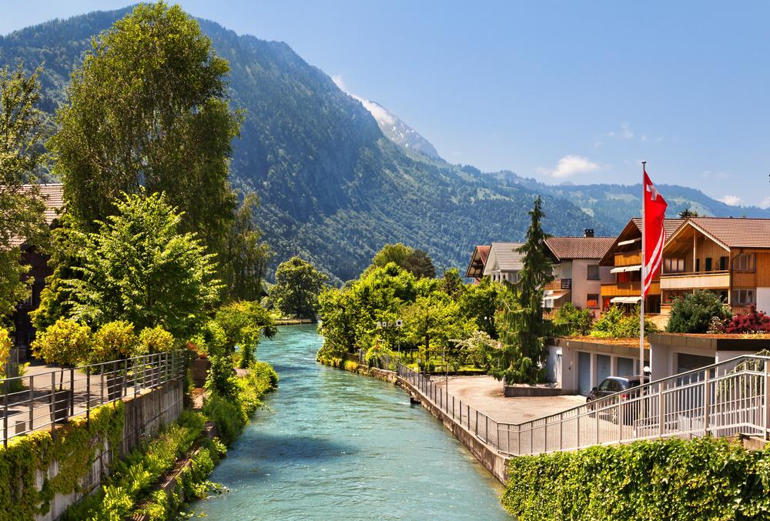
The Alpine Mountains

Slide 4
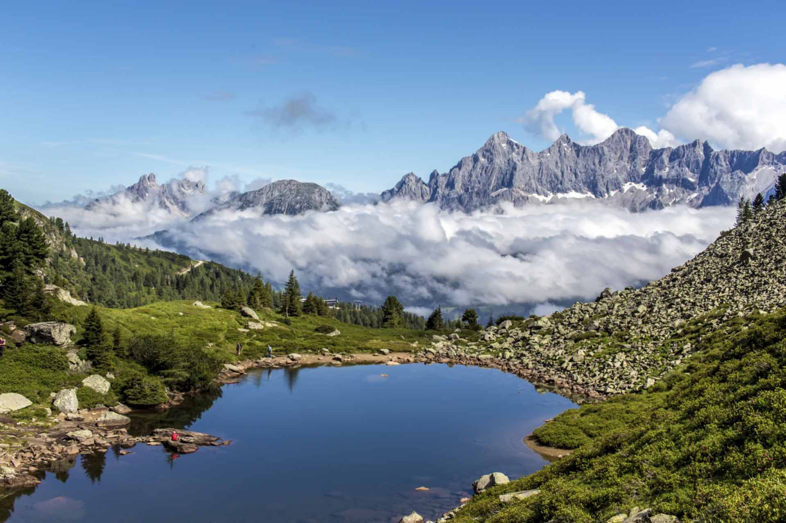
The Salzburg Mountains

Slide 5
Flag

Slide 6


Original
After 1945

Slide 7
History

Slide 8



Habsburg Empire
1526 ~ 1804
Austrian Empire
1804 ~ 1919
Republic of Austria
1919 ~ Nowadays

Slide 9
Thank You.

